Slide 1

Intro to Unit Testing with pytest
Chris Moriarty
Senior Software Engineer
Submillimeter Array

Slide 2
Outline
Why should I learn about software testing?
Overview of software testing lingo
Intro to unit testing
Pytest
Continuous Integration

Slide 3
Software Testing…boooo
Adds to development time
Usually not quite as interesting
Personal and open source projects don’t have paid test teams
Requires ongoing maintenance

Slide 4
Software Testing…yayy!!
Safety net
Helps ensure stability in large complex systems
No longer 100% responsible for manually testing your own code
Less bugs slip into production unnoticed
Several frameworks available, low barrier to entry
Looks good on resumes ;)
Notes:
Working on systems with no tests is stressful, making the smallest changes often have unintended consequences that sneak through.

Slide 5
Common Test Lingo
Unit Test
Testing individual pieces of code, think functions or classes as a “unit”
Run often by developers or with continuous integration framework
Integration Test
Generally when your code will be tested as part of the bigger system
Sometimes code gets developed isolated from the system
Regression Test
Usually done after unit and integration testing
Full end-to-end systems test, and compares the output or results to the last known good version of the code. Did anything change?

Slide 6
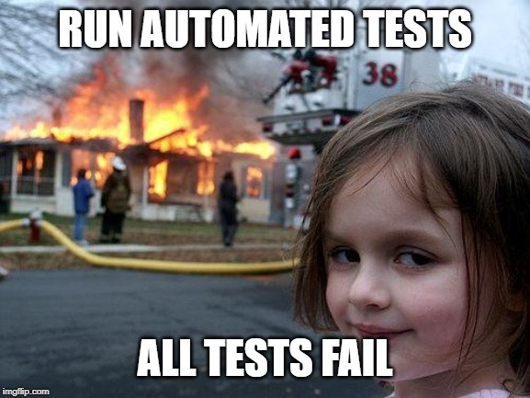
Unit Testing
Good documentation for other developers
Catches bugs earlier in development
Should be contained and fast
Should be easy to “update”
Easily automated
Safety net for new developers
Notes:
Good documentation
Tests show usage examples (and negative examples)
Also gives a test model to follow if you contribute new code
Catches bugs earlier in development
Existing tests can be run easily during development
Easily automated
Continuous integration
Safety net for new developers
Immediate feedback

Slide 7
Unit Testing with Python
unittest – comes bundled with python
nose – early improvement, less boilerplate code needed
pytest – quickly becoming a standard, supports unittest and nose

Slide 8
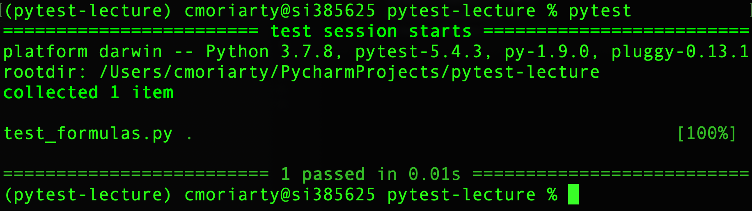
First unit test with pytest
File name needs test in the name: test_*.py or *_test.py
Function also starts with “test_” (ex: test_fibonacci())
Use the “assert” statement in front of a condition
# test_formulas.py
import formulas def test_fibonacci(): assert formulas.fibonacci(1) == 0 assert formulas.fibonacci(2) == 1
assert formulas.fibonacci(8) == 21
with pytest.raises(ValueError): formulas.fibonacci(-1)
Notes:
After this slide – Go switch in the optimized Fibonacci function, which is missing the -1 exception.

Slide 9
Demo – Improve performance
Notes:
Demo the new fib function. Should be missing the case for negative values.

Slide 10
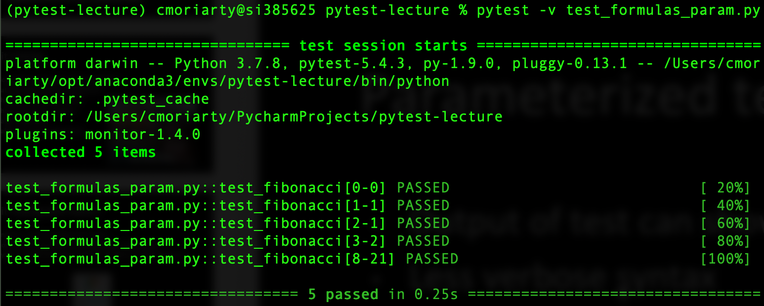
Parameterized test with pytest
Easier to test many inputs, rather than one by one
Annotate function with: @pytest.mark.parametrize
Output of test can show individual tests (pass –v)
import pytest import formulas test_data = [(0, 0),(1, 1),(2, 1),(3, 2),(8, 21)] @pytest.mark.parametrize("test_input,expected", test_data) def test_fibonacci(test_input, expected): assert formulas.fibonacci(test_input) == expected def test_fibonacci_negative():
with pytest.raises(ValueError): formulas.fibonacci(-1)

Slide 11
Continuous Integration
One of the main usages of CI is to trigger unit tests
Travis-CI is free for open source projects
Integrates with Github to run tests in the cloud
Great for collaborations and distributed teams
Demo time!

